Slide 1
used car price prediction price in Saudi Arabia regression models
Presented by/ Jamilah Rabeh
Supervised by/Dr.mejdel Alqahtani

Slide 2
Abstract
Our project aimed to applied regression model to predict price of cars in Saudi country that change according to certain attributes and companies
this project may help people to have a clear vision about car prices and what the main factors that has highly influence
I used web scraping to obtain data from syarah web site
I applied multi leaner regression such as : simple leaner regression ,Lasso and polynomial regression
R^2 in lasso and simple leaner regression are worst which represent under fitting prediction for them overcome that by building polynomial regression which give a good prediction model

Slide 3
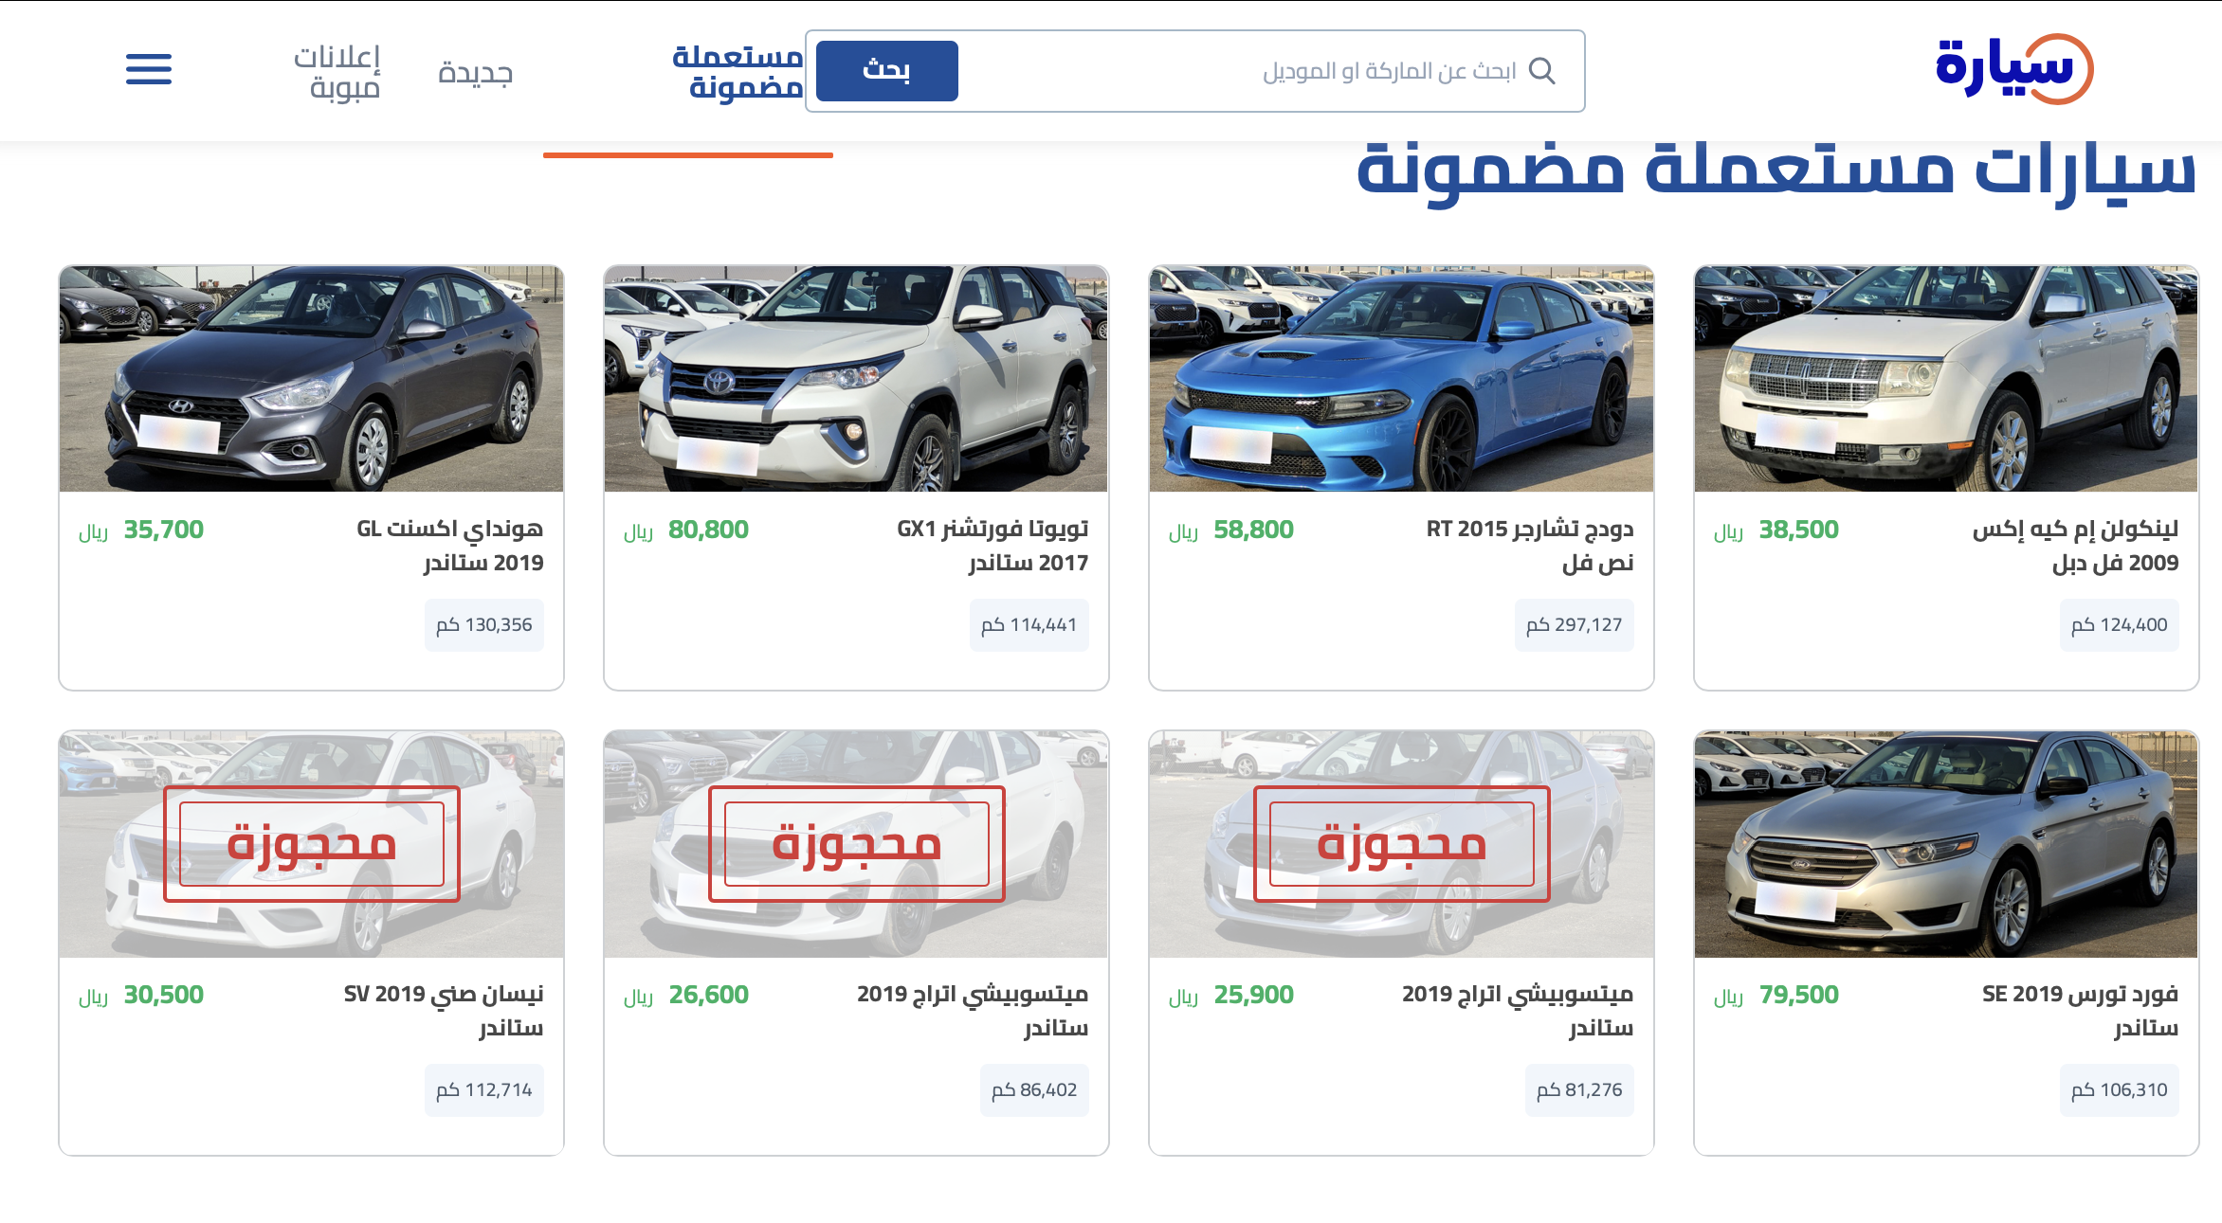
Data
Features
Car name
Model
Mileage
Engine size
Options
Fuel type
Regions
Origin
color
price
DS=8765X10

Slide 4
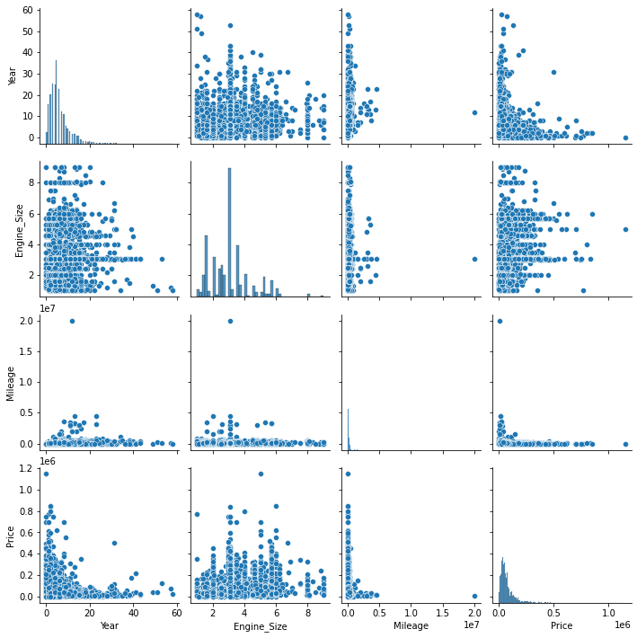
EDA
handling missing values and outlier some feature
visualized distribution and correlation of features
detect multicolleanerity by Variance Inflation Factor
Generated ‘car age column’ and ‘fuel economy’
Label encoding for categorical columns

Slide 5
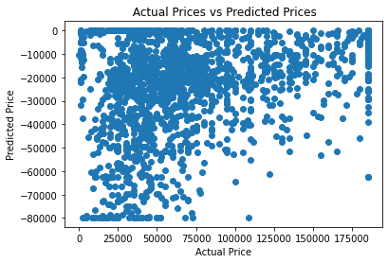
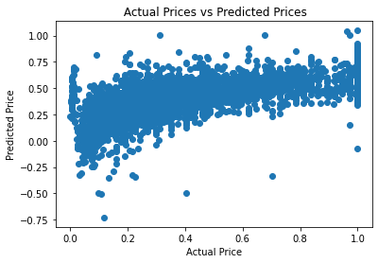
Simple leainer regression
Leainer reg | R^2 | MAE | MSE | RMSR
Training | 0.4425 | 0.1492 | 0.0393 | 0.1983
Testing | -3.7696 | 96325 | 1148 | 10714

Slide 6
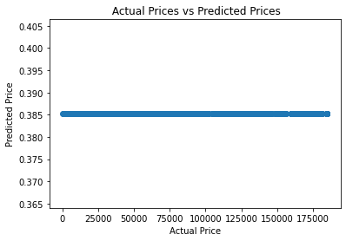
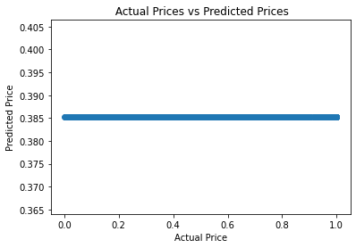
Lasso Regression
Lasso | R^2 | MAE | MSE | RMSR
Training | 0.0 | 0.2107 | 7518 | 8670
Testing | -2.1235 | 71493 | 7518 | 8670

Slide 7
Polynomial Regression

